Slide 1
Welcome!
Hari Polnati

Slide 2
Collection Framework and Generics

Slide 3
Quick Overview Wrapper Classes
What are Wrapper Classes?
A wrapper class wraps (encloses) around a data type and gives it an object appearance
Wrapper classes are final and immutable.
Types
Wrapper: Boolean,Byte,Character,Double,Float,Integer,Long,Short
Primitive: boolean,byte,char ,double, float, int , long,short
Why Wrapper Classes?
Creation from other data types
Integer hundred = Integer.valueOf("100"); Boolean value = Boolean.valueOf("True");
Autoboxing
Autoboxing is the automatic conversion that the Java compiler makes between the primitive types and their corresponding object wrapper classes.
Auto Boxing uses the static valueOf methods.

Slide 4
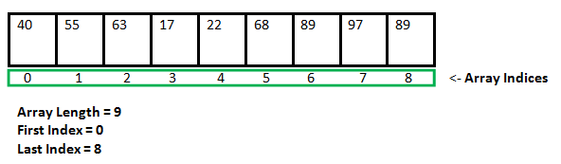
What and Why
Let’s understand Arrays first
Arrays are fixed in size.
Once we create an array there is no way to increase or decrease the size in advance
Homogeneous

Slide 5
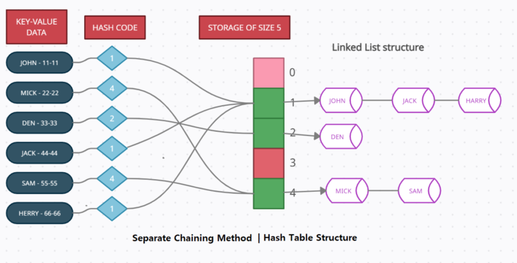
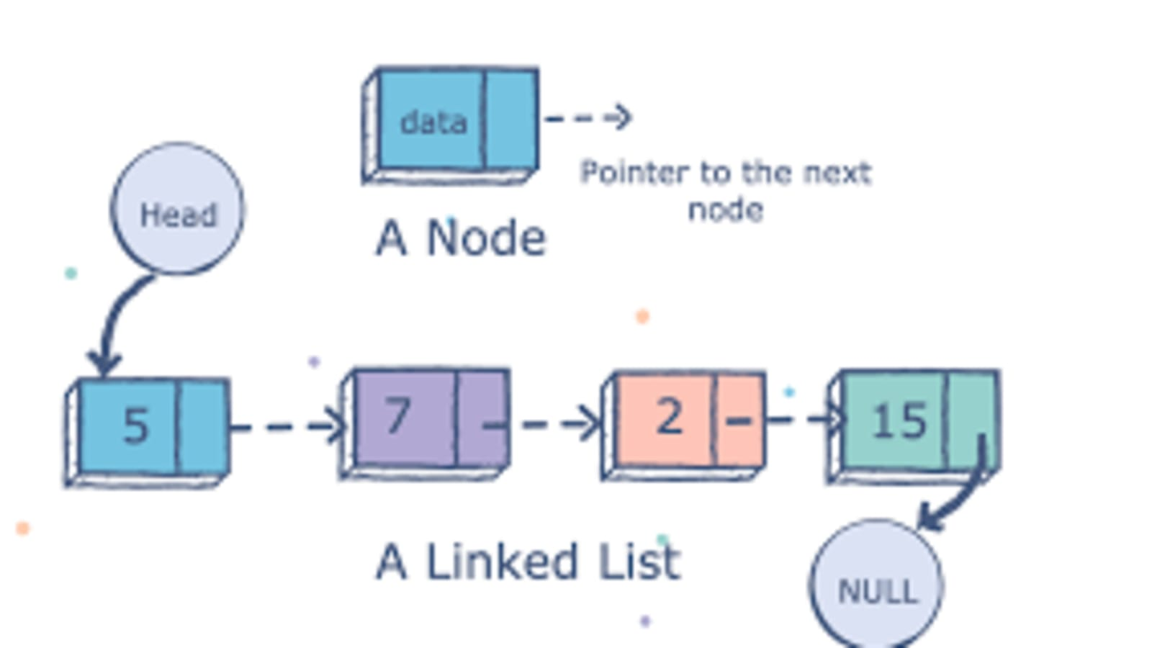
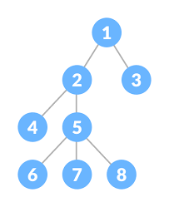
LinkedList
Hashtable
Tree

Slide 6
Collections
We want to focus on data structure or business logic ? => BL
Java provides built in collections
Collections
List - Ordered, Duplicates Allowed
Set - Unordered, Duplicates Not Allowed
Queue - Ordered. FIFO
Map - Key value pair

Slide 7
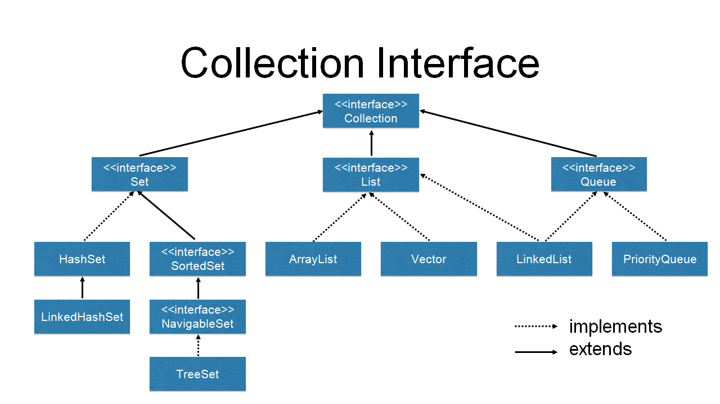
Insertion order preserved. Duplicates Allowed
Insertion order is not preserved. No duplicates
Ordered. All elements get inserted at the "end" and removed from the "beginning" (or head) of the queue

Slide 8
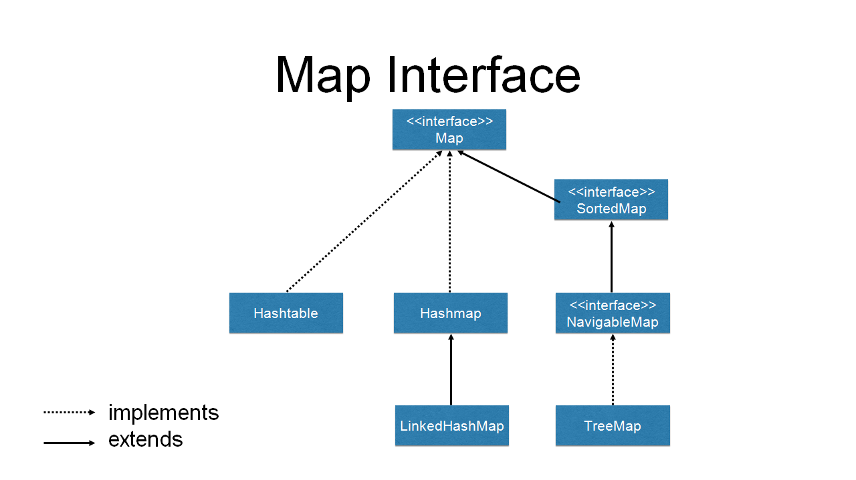
key, value data structure
Un-Sorted
Sorted based on Key

Slide 9
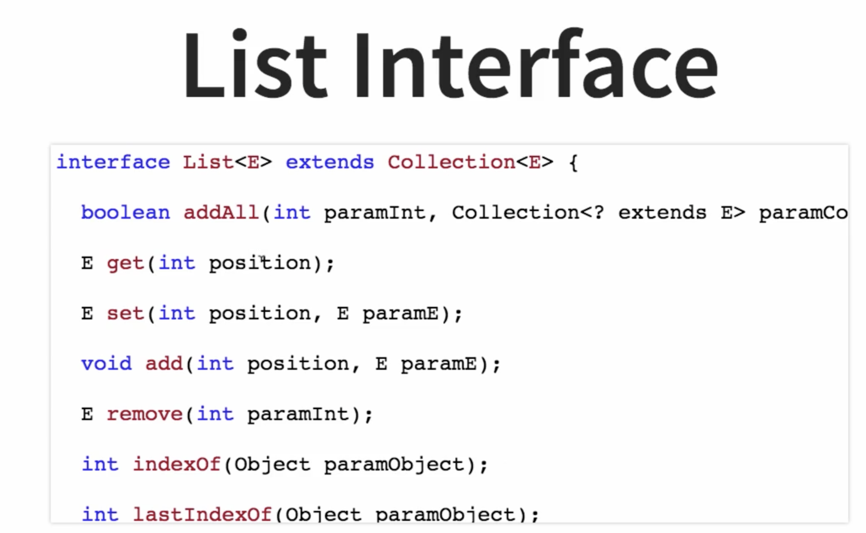

Slide 10
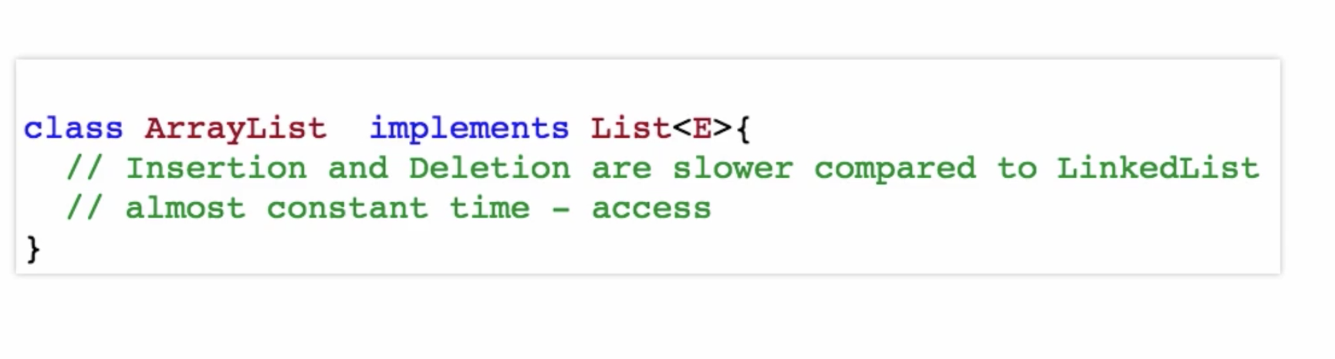
ArrayList (Dynamic array – grow or shrink)

Slide 11
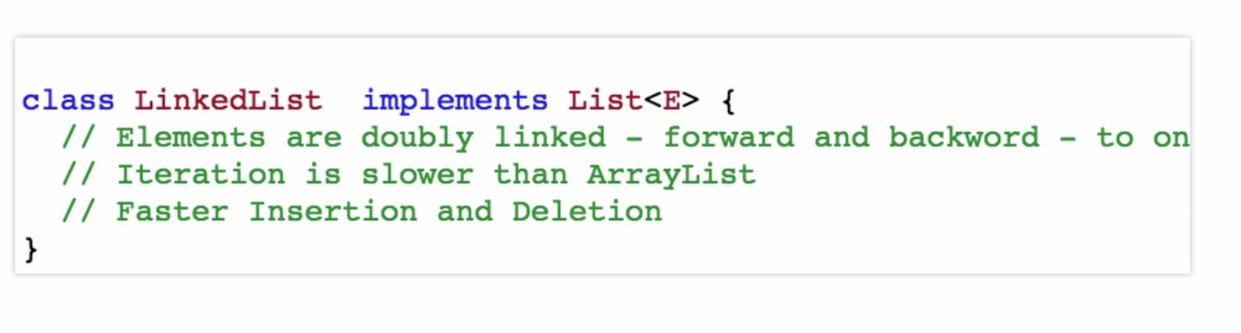
LinkedList (DoublyLinkedList)

Slide 12
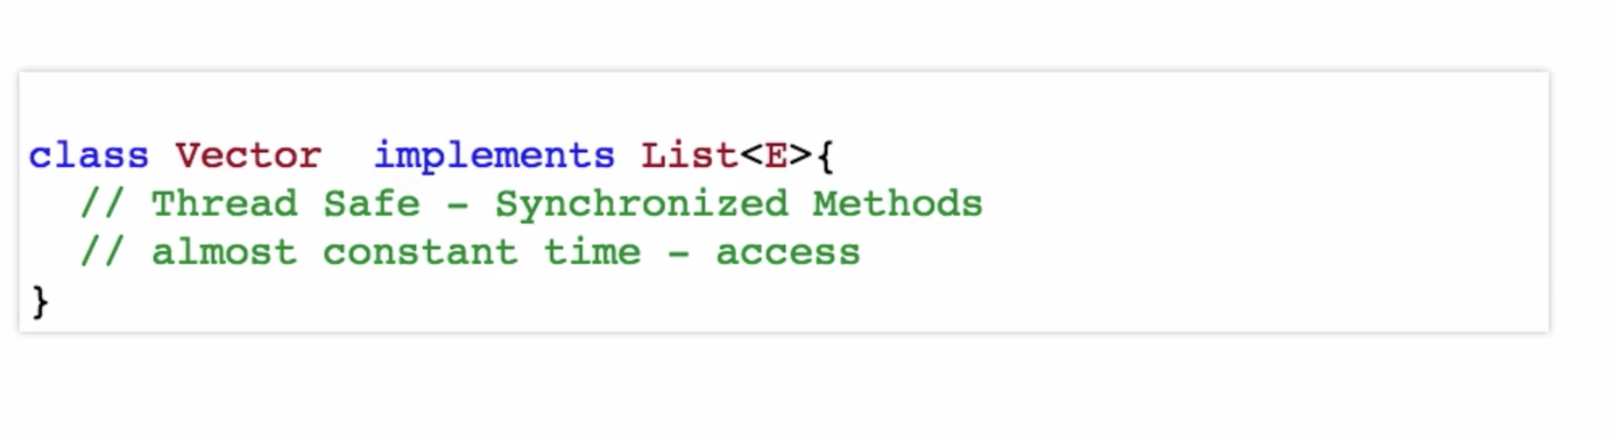
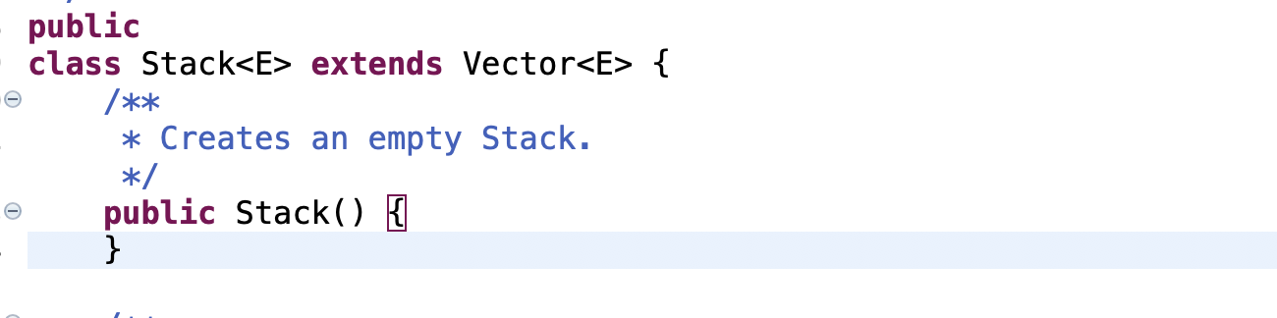
Vector (Dynamic array – grow or shrink)
Stack - LIFO
}

Slide 13
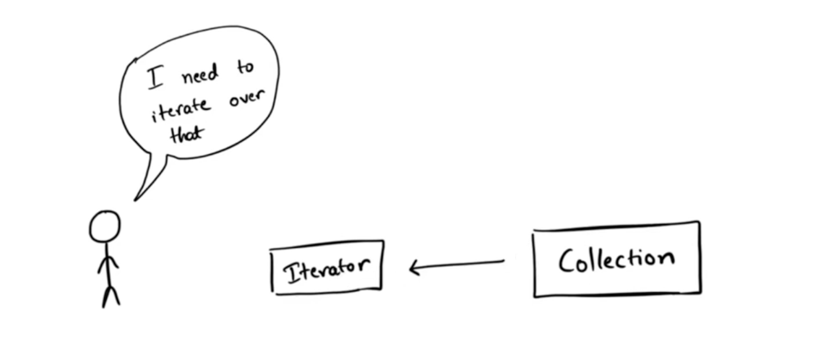
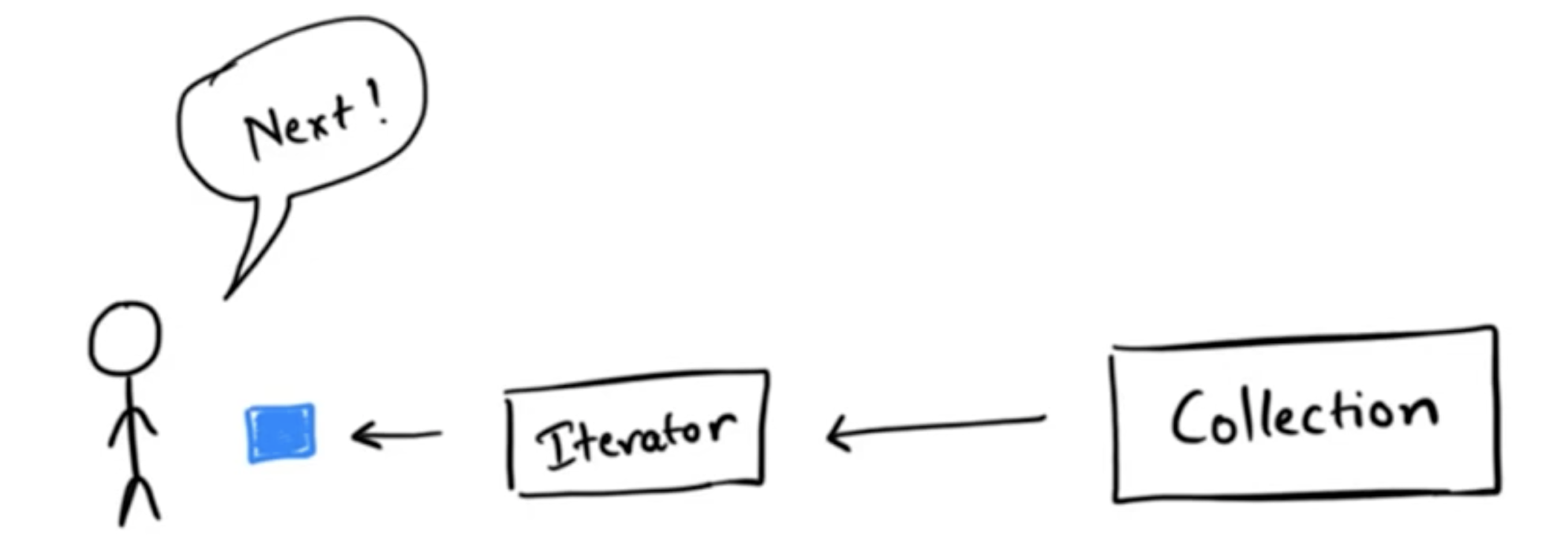
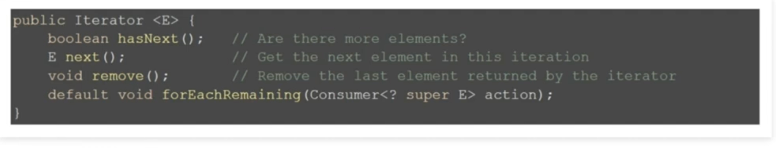
Iteration Approaches for Collections
Indexed for loop
Enhanced for loop
An Iterator
1
2
Iterator Interface

Slide 14
List Performance
ArrayList – (n elements)
get -> O(1)
set -> O(1) (replace/update)
contains -> O(n)
remove(0) -> O(n)
add(0) -> O(n)
LinkedList – (n elements)
get -> O(n)
set -> O(n) (replace/update)
contains -> O(n)
remove(0) -> O(1)
add(0) -> O(1)
When to use What: Position based Access -> ArrayList
Lot of additions and removals -> LinkedList

Slide 15
DS Visualization
https://visualgo.net/en
https://www.cs.usfca.edu/~galles/visualization/Algorithms.html
https://bost.ocks.org/mike/algorithms/

Slide 16
Equality in Objects

Slide 17
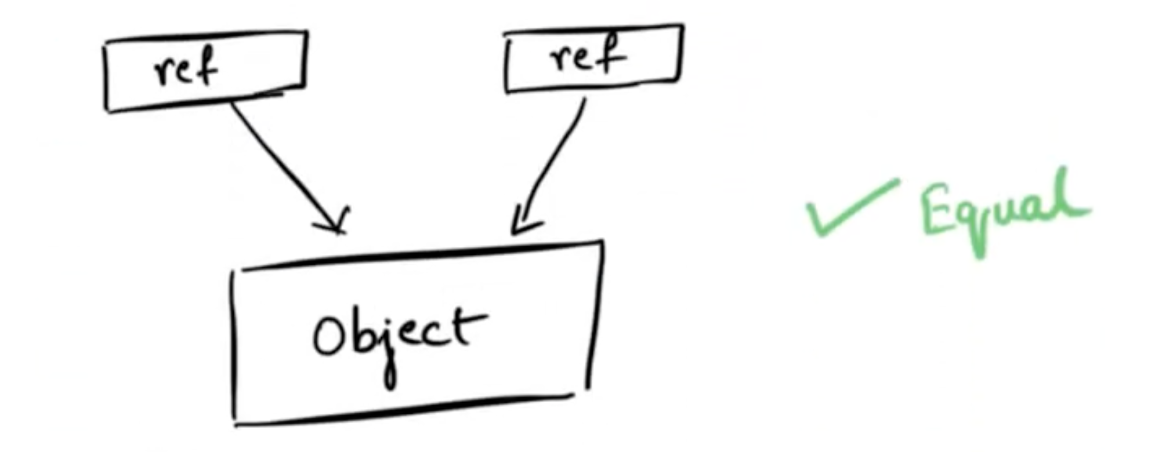
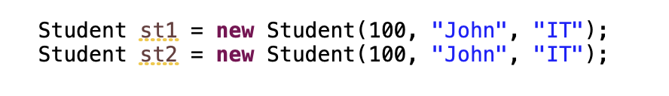
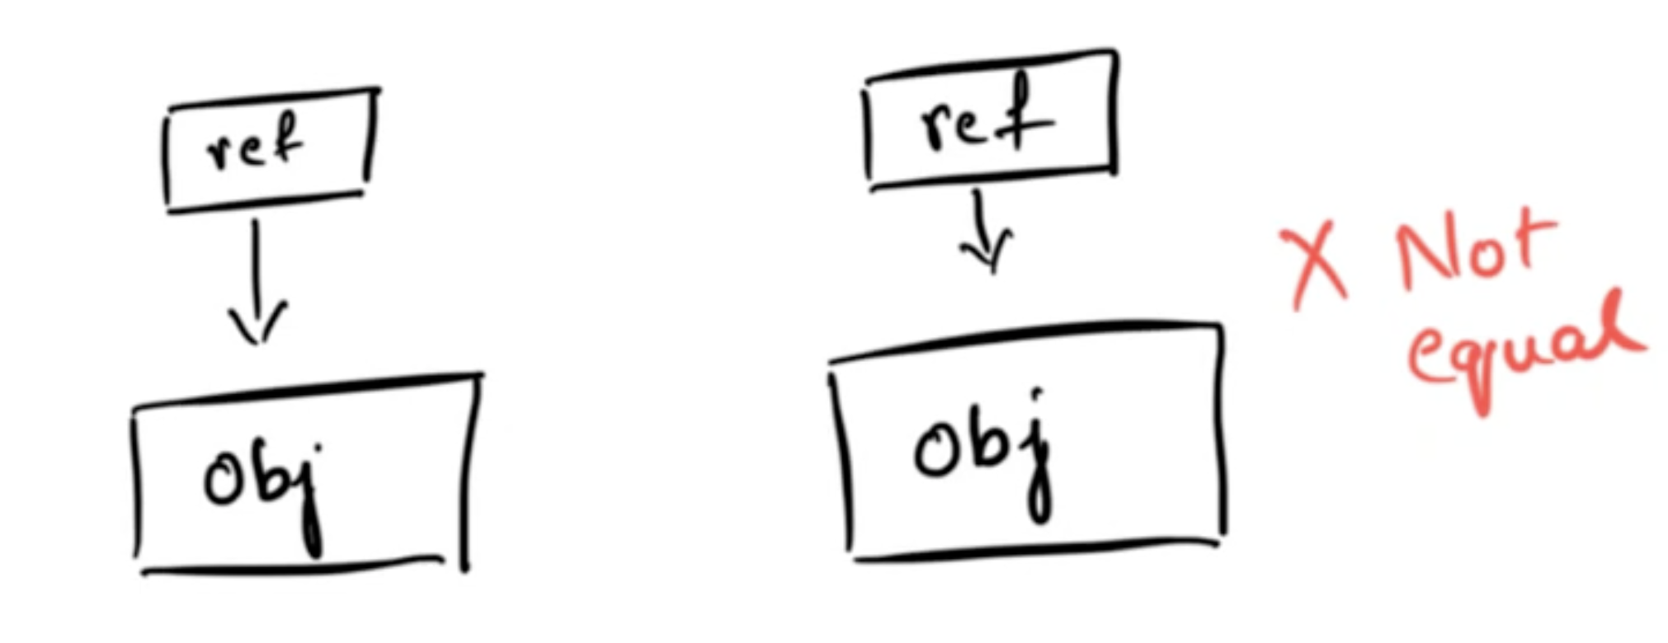
Equality in Objects
Equality => (the == operator)
With Primitives
5 == 5
2.0 == 2.0
‘a’ == ‘a’
With Objects
1
==
What is .equals() method?
O/P => true
Both are equal ?
st1
st2
==
O/P => false

Slide 18
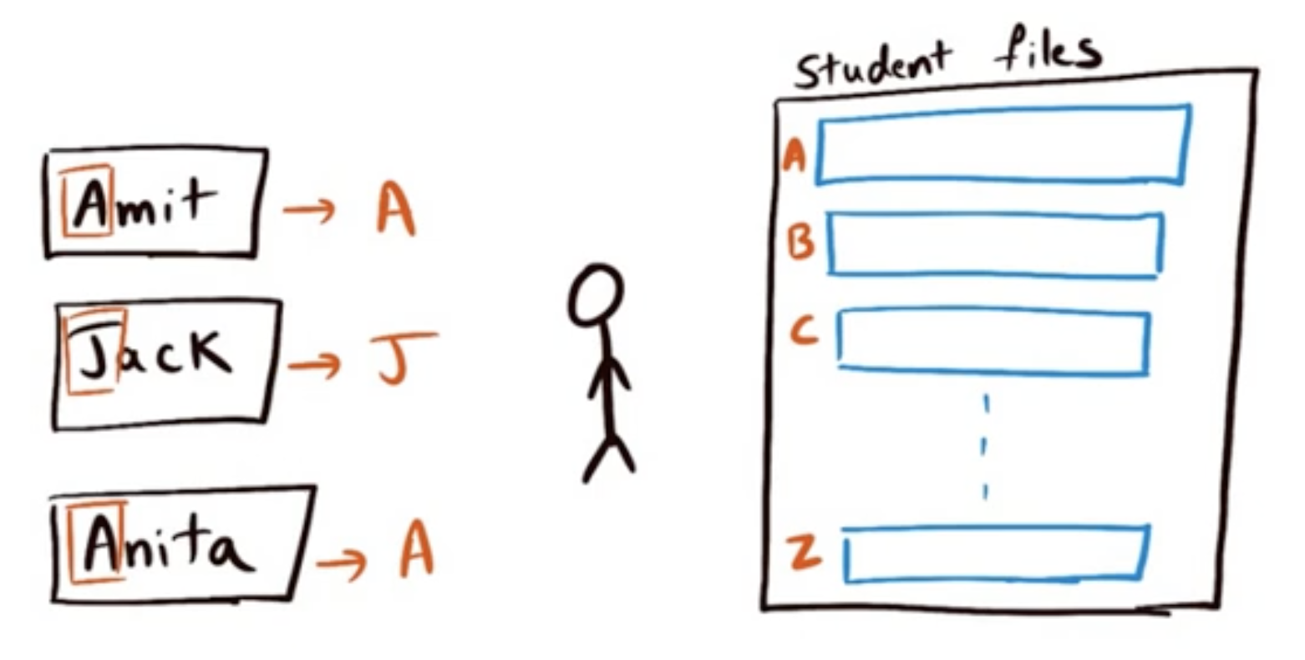
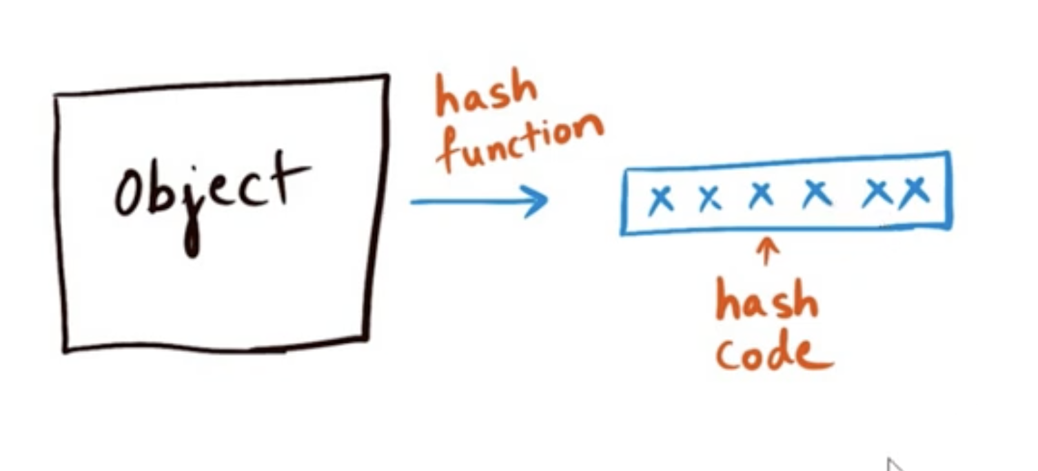
Hashing and hashcode
Hashing means using some function or algorithm to map object data to some representative integer value
1
2
Accountant
4
3
What is .hashCode() method?
HF(x)

Slide 19
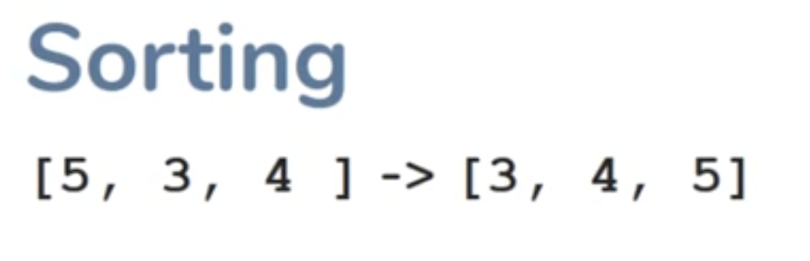
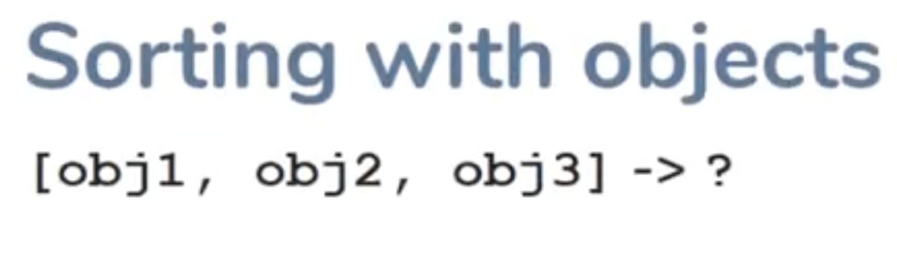
Sorting Objects
What does it mean by object sorting ? Each object contains multiple properties.

Slide 20
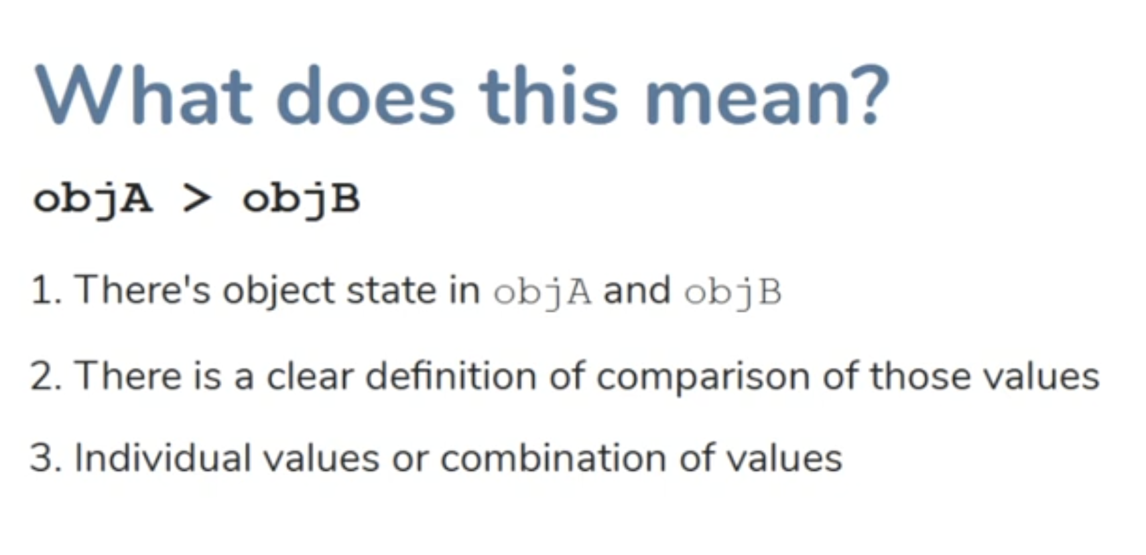
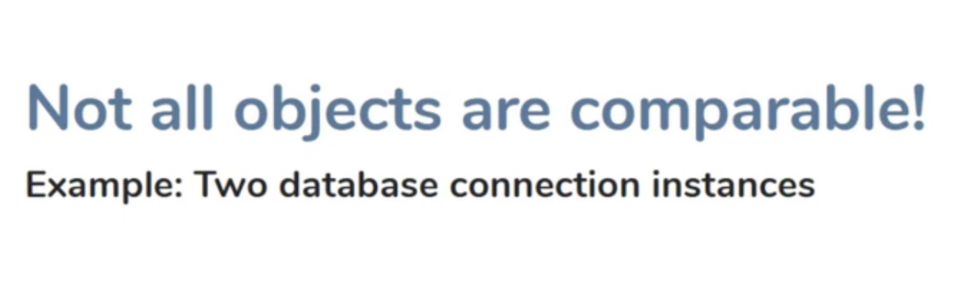
** Have a quick look on Generics before coding comparable

Slide 21
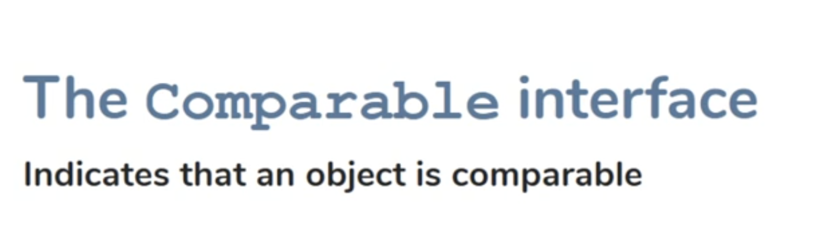
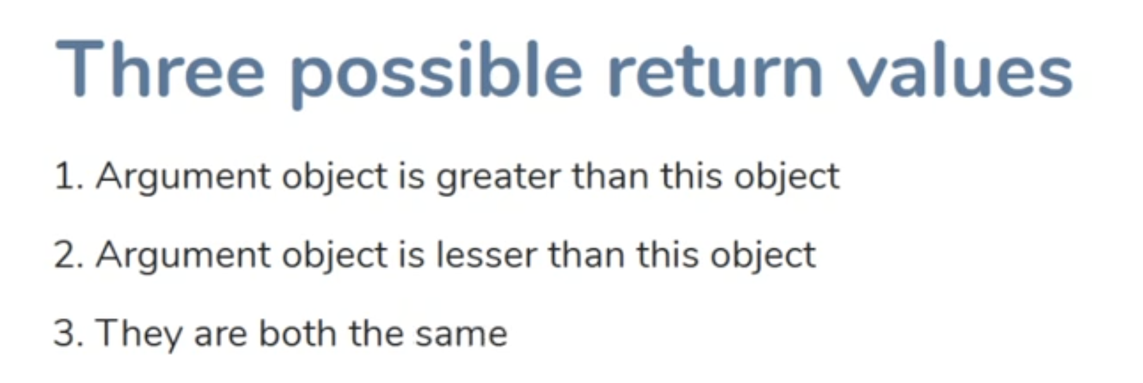
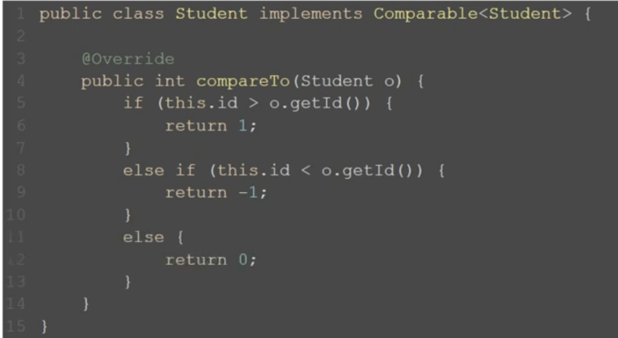
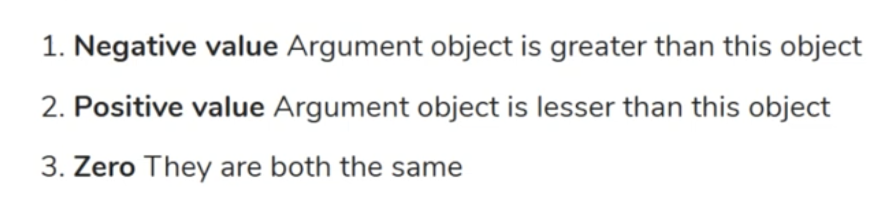
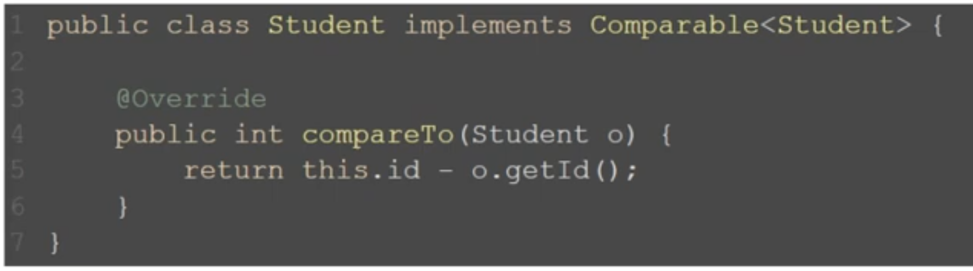
1
2
4
3
Shorter Way
5

Slide 22
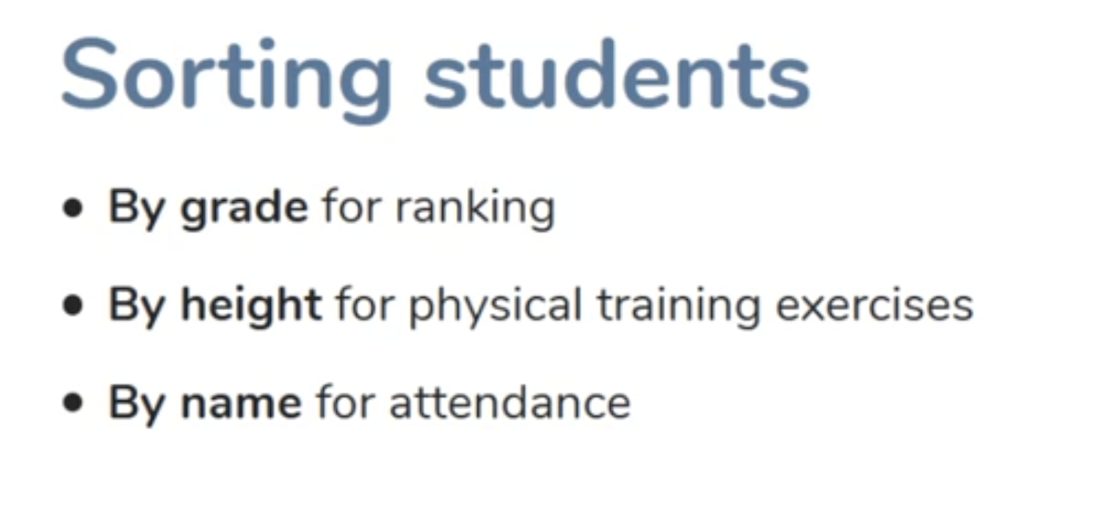
Custom Comparators
Sometimes sorting depends on Context.
In Comparable Interface we have only compareTo method ☹

Slide 24
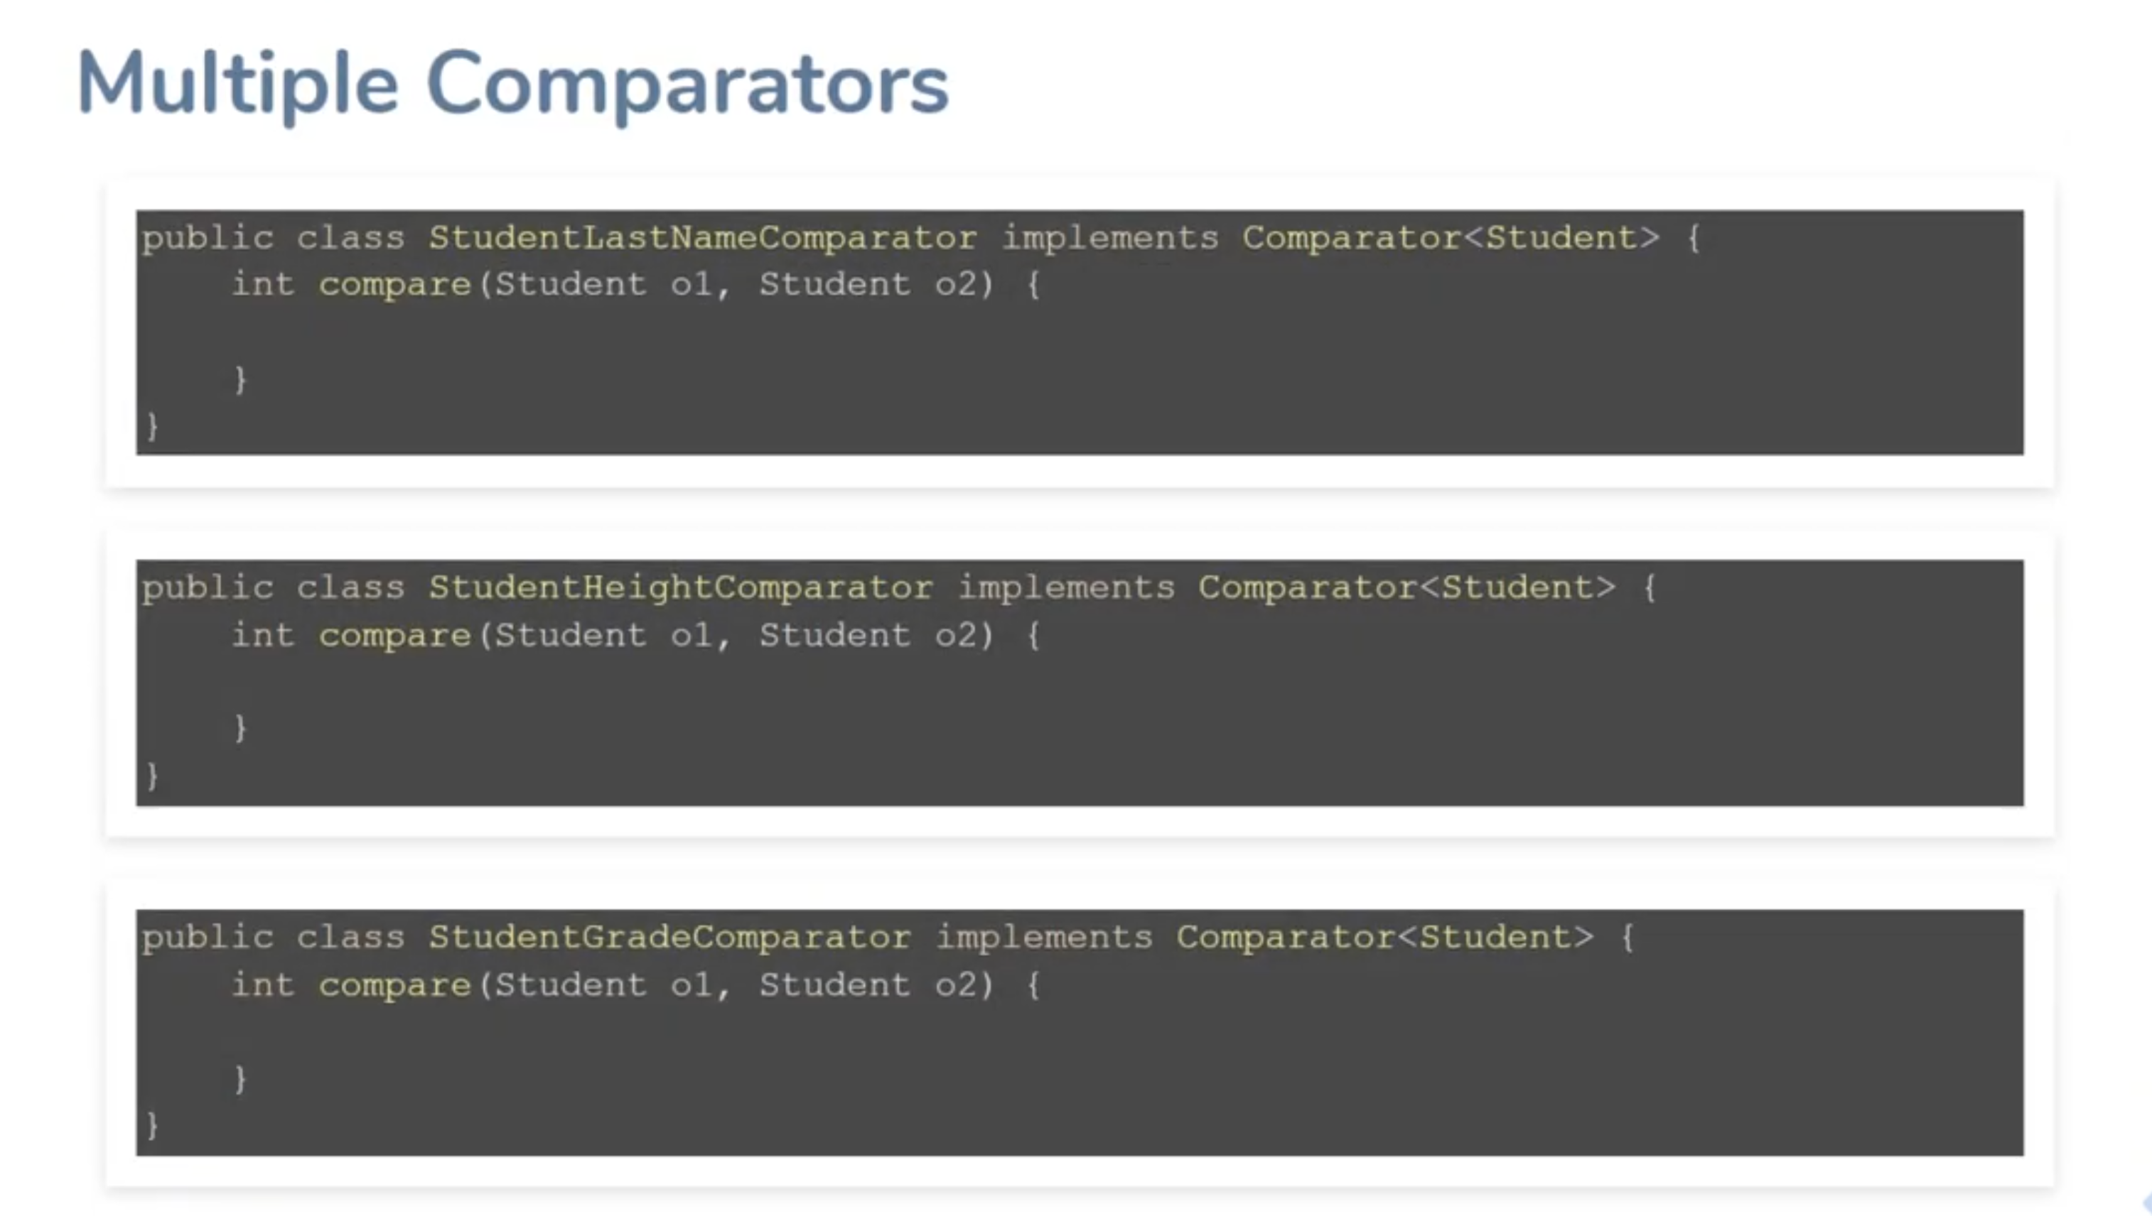

Slide 25
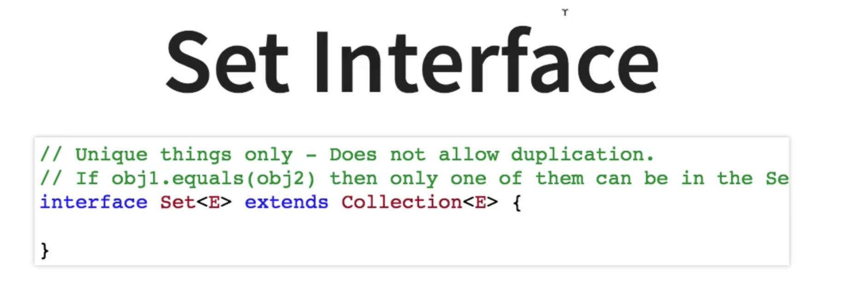

Slide 26
HashSet (Hashtable)

Slide 27
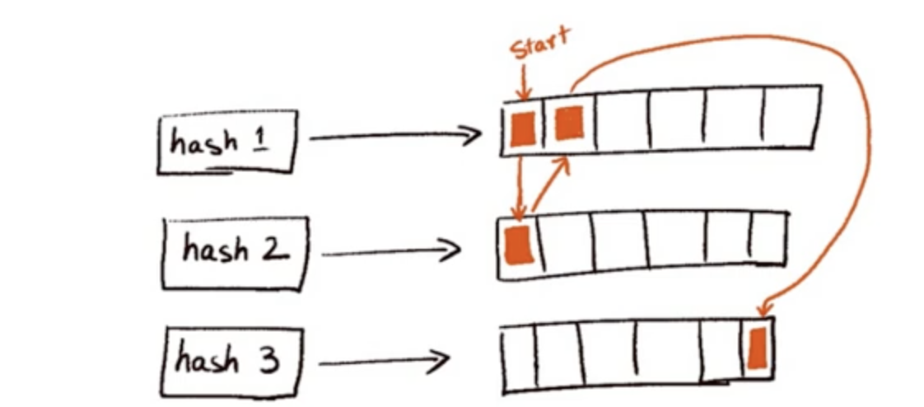
LinkedHashSet (LinkedHashMap)

Slide 28
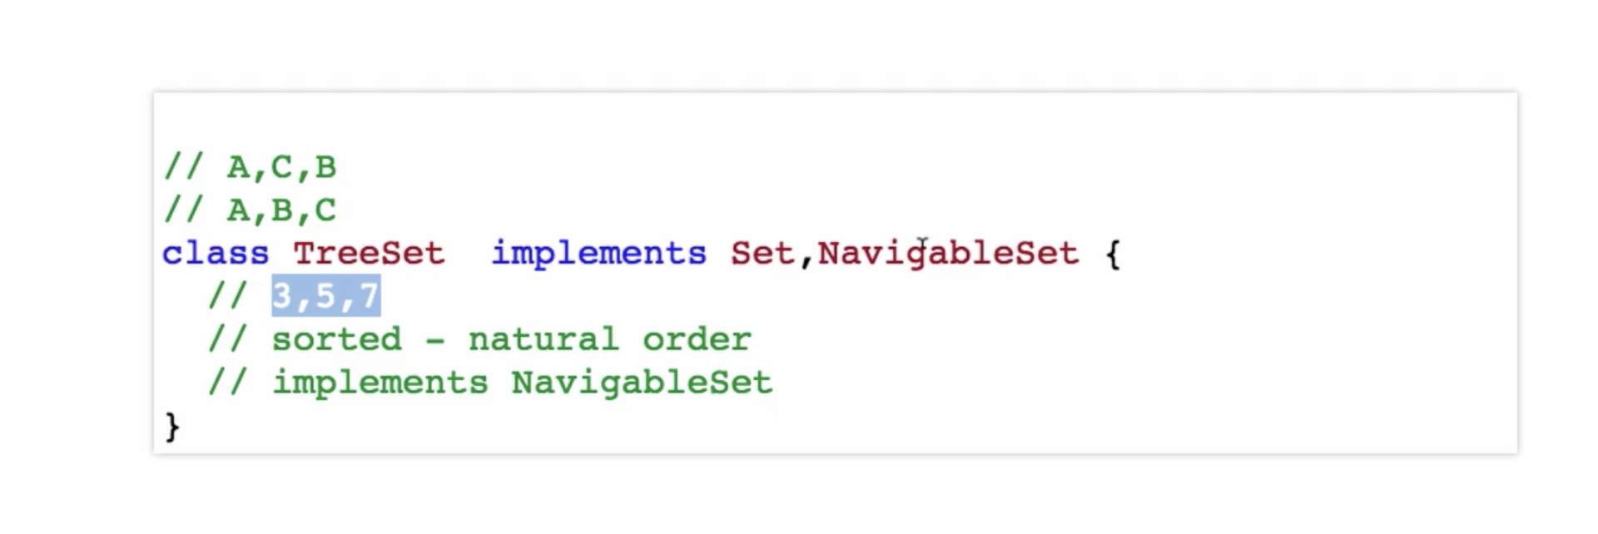
TreeSet (TreeMap (Red-BlackTree))
Requirements
Must be comparable

Slide 29
Set Performance
Position is not matter
Fast lookup (contains) – check something exists or not
HashSet vs TreeSet
Order is not important
Sorting is not important
Good Hashing Strategy
Order is not important
Sorting is important
add – O(1)
remove – O(1)
contains – O(1)
add – O(logN)
remove – O(logN)
contains – O(logN)

Slide 30
Queue
Arranged in order of Processing.
Examples: Calendar Meetings Attendance, Todo –List, Jenkin jobs, Azure Devops tasks
Queue interface extends Collection interface. So, Queue will supports all collection interface methods

Slide 31
PriorityQueue. (Queue with the Heapify technique – Default is Min-Heap)

Slide 32
The dictionary

Slide 33
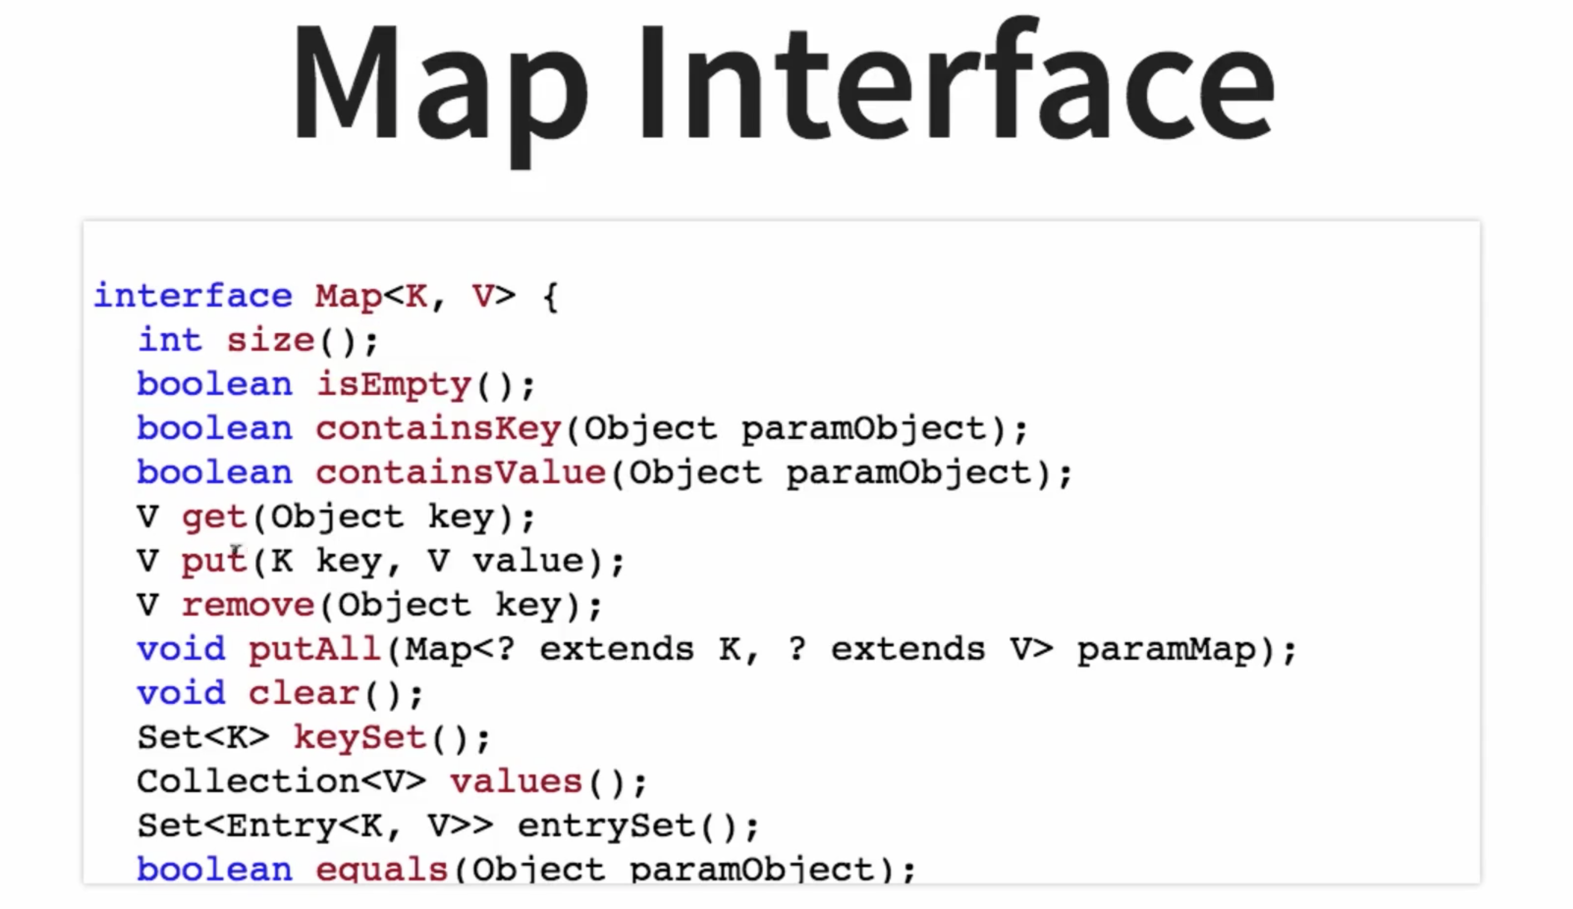

Slide 34
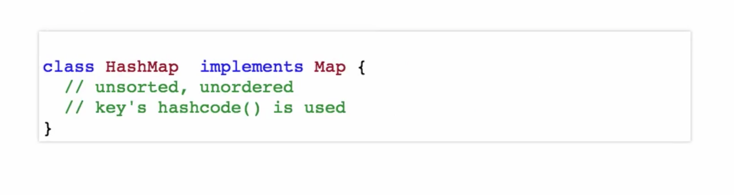
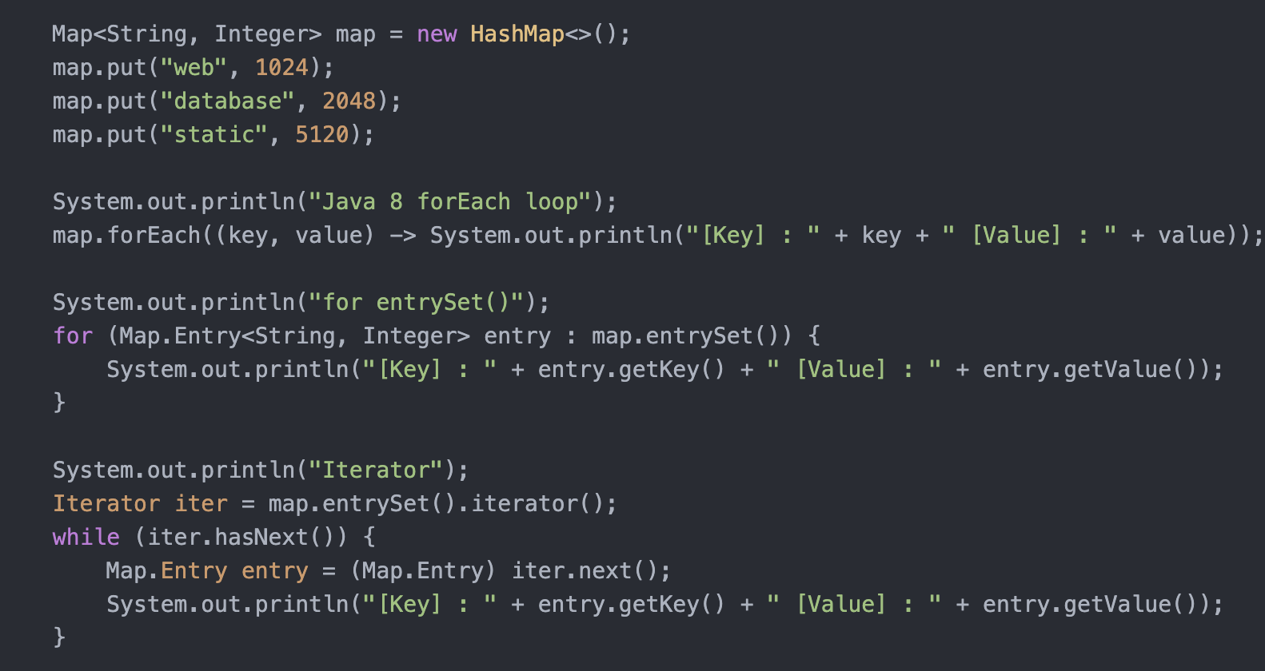
HashMap

Slide 35
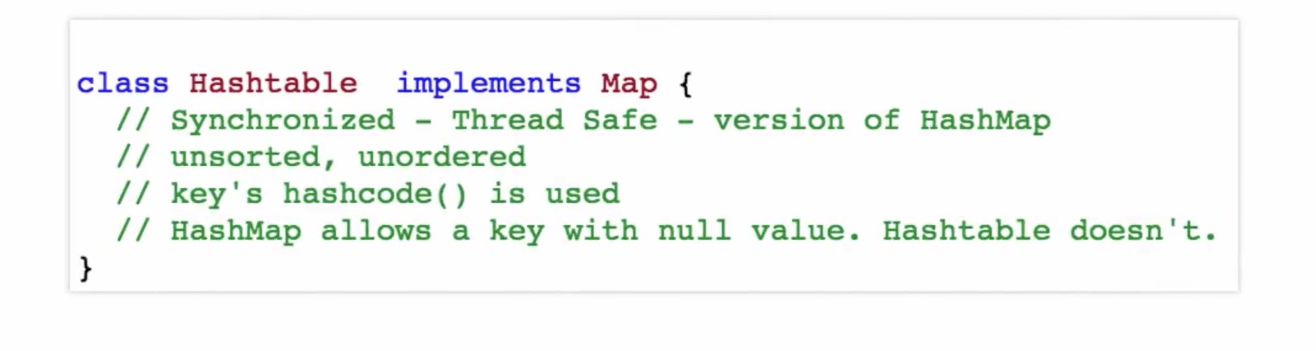
Hashtable

Slide 36
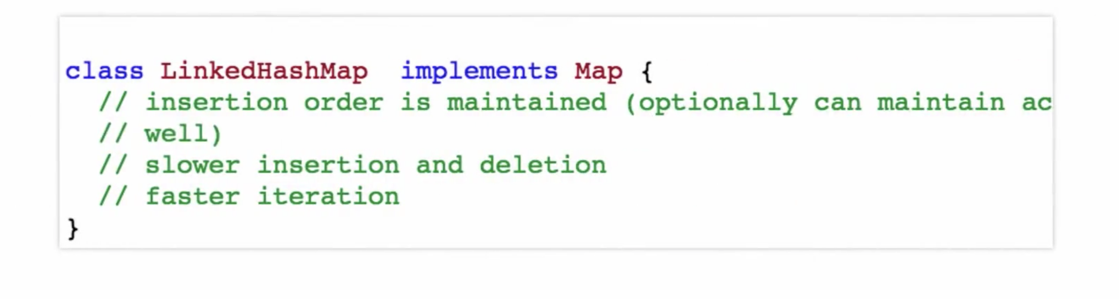
LinkedHashMap

Slide 37
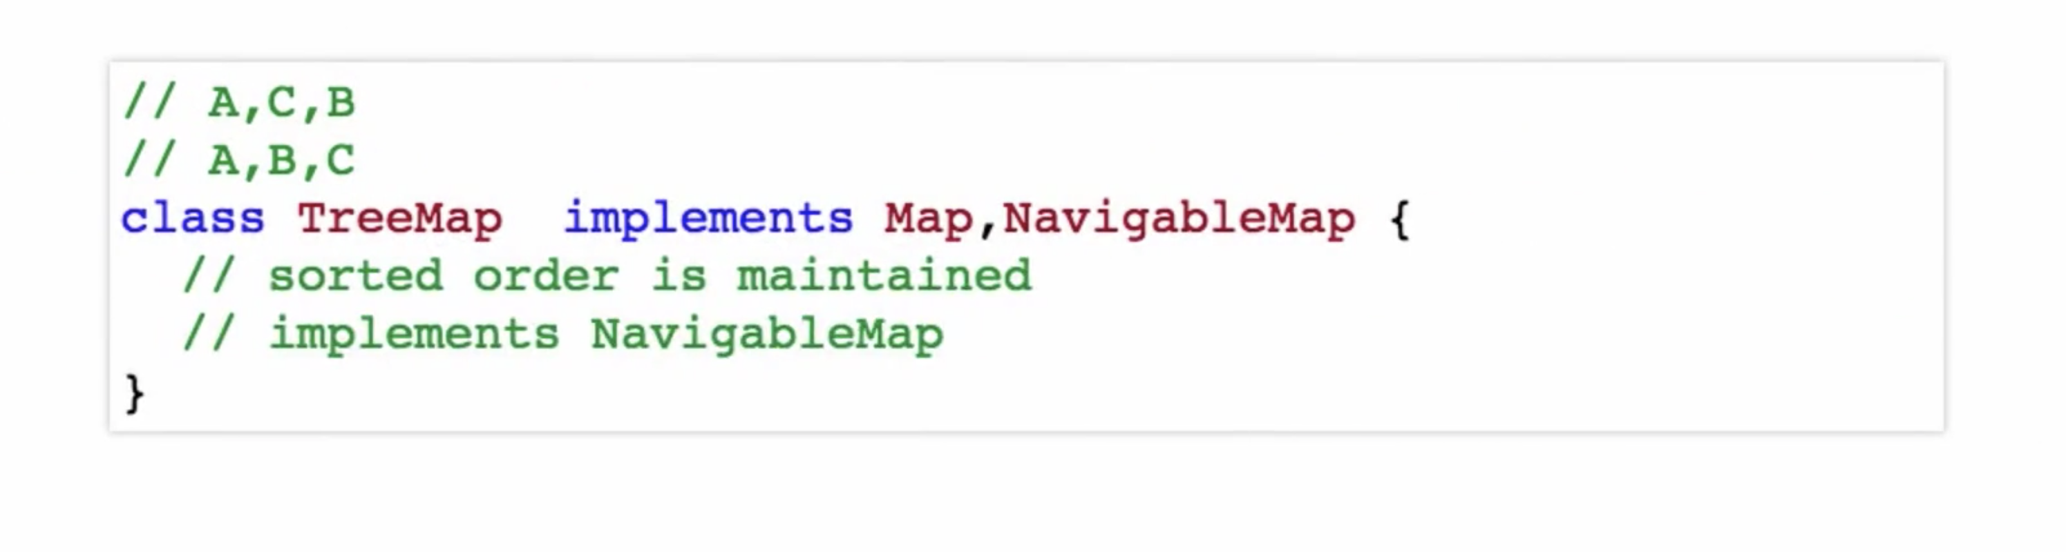
TreeMap

Slide 38
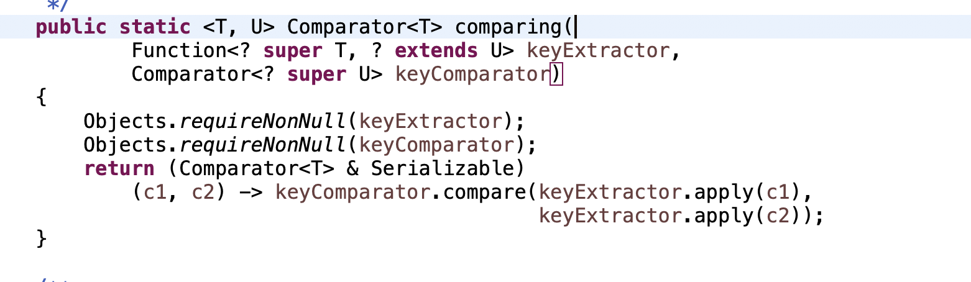
Generics
One of the method in Comparator Interface

Slide 39
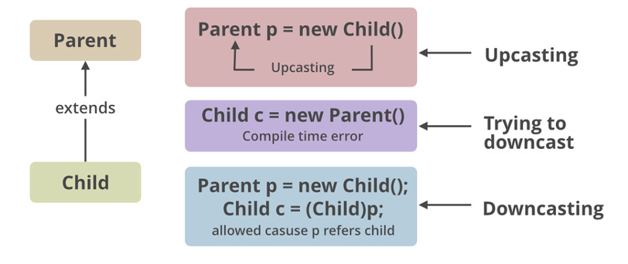
Let’s Understand Type Casting
Upcasting/Widening (Automatic) -> Casting from a subclass to a superclass. Typically, the upcasting is implicitly performed by the compiler.
Ex1: Cat cat = new Cat();
Animal animal = cat; (implicit casting)
Animal animal = (Animal) cat; (We could do explicitly also)
Ex2: byte -> short -> char -> int -> long -> float -> double
Downcasting/Narrowing (Manual) -> Casting from a superclass to a subclass.
Ex: double -> float -> long -> int -> char -> short -> byte

Slide 40
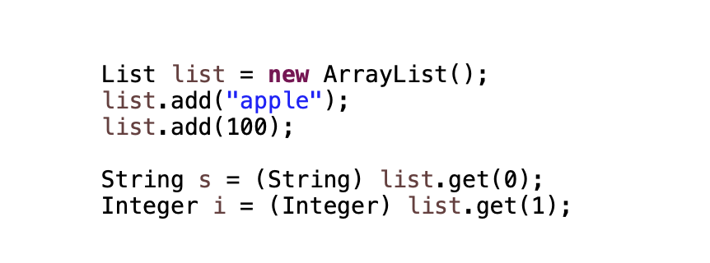
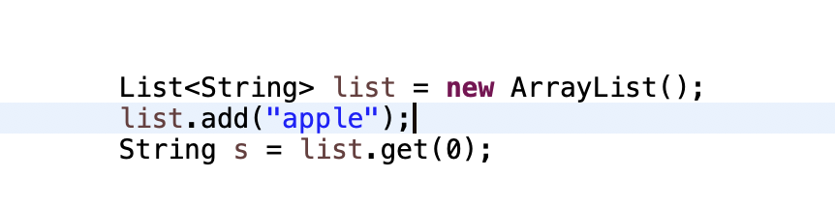
Generics
- (introduced in Java 1.5)
Why Generics
Java compiler doesn’t have knowledge about the type of the data stored in Non-Gen. Need to do explicit cast while retrieving the stored data.
Stronger type checks at compile time
Generics add the type-safety – (heart of generics)
Adds stability to the code by making more of bugs deductible at compile time
Without Generics
With Generics
** angular brackets “<>”
https://docs.oracle.com/javase/tutorial/java/generics/why.html

Slide 41
Implement Generics
// a parameterized (generic) class
public class name<Type> {
or
public class name<Type, Type, ..., Type> {
By putting the Type in < >, you are demanding that any client that constructs your object must supply a type parameter.
You can require multiple type parameters separated by commas.
The rest of your class's code can refer to that type by name.
The convention is to use a 1-letter name such as: T for Type, E for Element, N for Number, K for Key, or V for Value.
The type parameter is instantiated by the client. (e.g. E → String)

Slide 42
Wildcards in Generics
Unbounded Wildcards: List<?> represents a list of unknown type
Upper Bounded Wildcards: List<? extends Number> represents a list of Number or its sub-types such as Integer and Double
Lower Bounded Wildcards: List<? super Integer> represents a list of Integer or its super-types Number and Object

Slide 43
Bounded type Parameters
Bounded means “restricted”
<Type extends SuperType>
An upper bound; accepts the given supertype or any of its subtypes.
<Type super SuperType>
A lower bound; accepts the given supertype or any of its supertypes.
? indicates a wild-card type parameter, one that can be any type.
List<?> list = new List<?>(); // anything
Difference between List<?> and List<Object> :
? can become any particular type; Object is just one such type.
List<Object> is restrictive; wouldn't take a List<String>

Slide 44
Queries ?

Slide 45
Thank you!

